Slide 1

Lecture 8: Memory and Process Management
Eng / Youssef khaled
Backend Roadmap

Slide 2
What is Memory Management?
Memory management is the process of controlling and coordinating a computer's memory.
It allocates memory to programs when needed and frees it when done.
Example: Running multiple programs like a browser and a music player.

Slide 3
Types of Memory
- RAM (Random Access Memory): Temporary, fast memory used by programs.
- Virtual Memory: Extends RAM by using part of the hard drive.
Example: When RAM is full, the OS uses virtual memory.

Slide 4
How the OS Manages Memory
The OS allocates memory to programs as they run.
It keeps track of which memory is free and which is in use.
Example: The OS assigns memory when you open a browser.

Slide 5
What is Process Management?
Process management handles the execution of running applications.
A process is a running program.
Example: When you open a game, it becomes a process in the OS.

Slide 6
Multitasking
The OS can run multiple processes at the same time.
It switches between processes quickly, so it seems like everything is running at once.
Example: Playing music while browsing the internet.

Slide 7
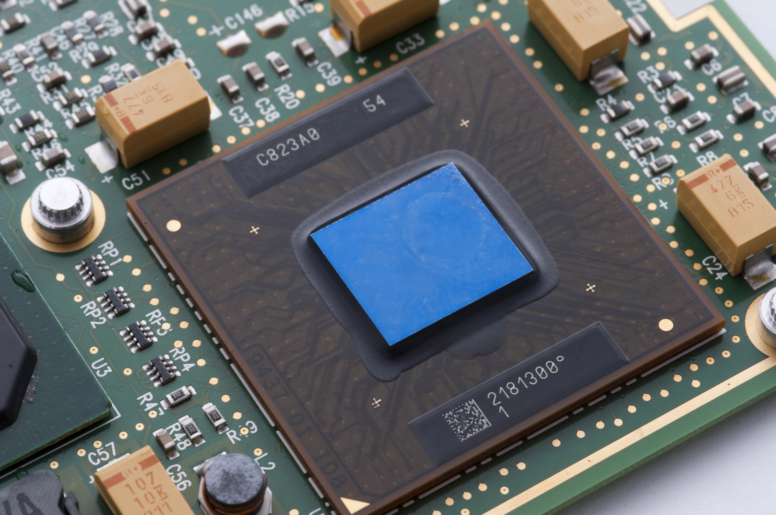
Process States
- Running: Actively using the CPU.
- Waiting: Waiting for input or resources.
- Terminated: Completed or closed.
Example: A video editor waits for input when idle.
ThePhoto by PhotoAuthor is licensed under CCYYSA.

Slide 8
What is a Process Scheduler?
The process scheduler decides which process gets CPU time.
It ensures fair distribution of resources among processes.
Example: The OS gives time to each app running on your computer.

Slide 9
Virtual Memory Management
Virtual memory allows the OS to use the hard disk as extra RAM.
It helps the system run more programs than available physical memory.
Example: Large programs use virtual memory when RAM is full.

Slide 10
Paging and Segmentation
- Paging: Divides memory into fixed-size pages.
- Segmentation: Divides memory into variable-sized segments.
Example: The OS uses paging to efficiently manage memory.

Slide 11
Summary
- Memory management allocates and frees memory for programs.
- Process management handles running applications.
- Key techniques: multitasking, virtual memory, and process scheduling.

